Slide 1

Community Development Block Grant (CDBG)
Program
Kelly Hansen, County of Mendocino
3/7/25

Slide 2

Purpose of CDBG
The primary federal objective of the CDBG program is the development of viable urban communities by:
Providing decent housing
Suitable living environment
Expanding economic opportunities
Principally, for persons of low- and moderate-income.
.
* LMI = “Persons of low and moderate income” are defined as families, households, and individuals whose incomes do not exceed 80% of the county median income, adjusted for family or household size.
Notes:
* LMI = “Persons of low and moderate income” are defined as families, households, and individuals whose incomes do not exceed 80% of the county median income, adjusted for family or household size

Slide 3
What is CDBG?
The California Department of Housing and Community Development (HCD) partners with rural cities and counties to improve the lives of their low- and moderate-income residents through the creation and expansion of community and economic development opportunities in support of livable communities. CDBG funds are provided as grants to non-entitlement jurisdictions that address one of three national objectives. Grants can vary based on annual allocations and activity limits.
Eligibility
As a non-entitlement jurisdiction [county with population less than 200,000], Mendocino County applies for CDBG program funding through HCD’s annual Notice of Funding Availability (NOFA) or directly with Program Income applications.
Subrecipients
Eligible Applicants. Local governmental entities, institutions of higher education, or an incorporated non-profit organization having 501(c) (3) status.
Ineligible Applicants. For-profit organizations and individuals.
Notes:
WHAT IS CDBG - The Community Development Block Grant (CDBG) Program is designed to assist rural cities and counties in improving economic opportunities and meeting community revitalization needs. HUD envisions CDBG funds to be used as gap financing to add the final necessary funds for a project to be successful. Grants vary based on annual allocations and activity limits.
WHO is ELIGIBLE - CDBG funds are provided as grants to non-entitlement jurisdictions ([cities with populations under 50,000 and counties with populations under 200,000) and cannot be used to supplant general fund dollars.

Slide 4
CDBG Projects & Programs
2 Project Criteria: meet a National Objective & be an Eligible Activity
1. National Objective
2. CDBG Eligible Activities
Benefit to Low-to-Moderate Income persons
  Area Benefit (LMA)
  Limited Clientele (LMC)
  Housing (LMH)
  Jobs (LMJ)
Aid in the prevention or elimination of blight, or
Projects that have a particular urgency because existing conditions pose a serious and immediate threat to the health or welfare of the community (not available under this RFP).
COMMUNITY DEVELOPMENT
Public Facilities and Improvements and Privately-Owned Utilities
Architectural Barrier Removal
Code Enforcement
Clearance, Rehabilitation, Reconstruction, and Construction of Buildings (including Housing)
Loss of Rental Income (not eligible for Program Income funding)
Relocation
Payment of Non-Federal Share
Homeownership Assistance
Housing Services
Lead-based Paint Hazard Evaluation and Reduction
ECONOMIC DEVELOPMENT
Microenterprise Assistance
Acquisition of Real Property
Planning & Capacity Building (not eligible for Program Income funding)
Planning Related to Another Activity (not eligible for Program Income funding)
Assistance to For Profit-Businesses
Resource to check LMI status of geographic locations: LMISD Map Application 2016-2020
* LMI = “Persons of low and moderate income” are defined as families, households, and individuals whose incomes do not exceed 80% of the county median income, adjusted for family or household size (see HUD income limits)
Notes:
Every project, program, or activity, including Program Income projects, that receives CDBG funds through HCD must meet two criteria: the project must meet a national objective and it must also be an eligible activity.
National objective: benefit to low-to moderate income persons, elimination of blight, urgent need.
LMA: Low/Mod Area Benefit (LMA) 24 CFR 570.483(b)(1) For the Low/Mod Area Benefit (LMA) objective, benefits must be available to all the residents of a designated service area in which at least 51 percent of the residents are Low/Mod. If census tracts or block groups are used to define the area, Grantees should use U.S. Census data together with CDBG Income Limits to determine eligibility. For service areas not aligned with census tracts or block groups, Grantees must conduct surveys, or use another HCD authorized alternative data set, to determine the Low/Mod percentage for the area.
LMC: Under the Low/Mod Limited Clientele objective, benefits are provided to a specific group of eligible persons rather than every person in a defined service area. Exclusively benefit clientele who are generally presumed by HUD to be principally Low/Mod income persons. The following groups are currently presumed by HUD to be comprised principally of LMI persons: Abused children, ✓ Elderly persons, ✓ Survivors of domestic violence, ✓ Persons experiencing houselessness, ✓ Adults who meet the Bureau of Census’ definition of severely disabled adults, ✓ Adults with functional illiteracy, ✓ Persons living with AIDS, and ✓ Migrant farm workers.
LMH: Low/Mod Housing 24 CFR 570.483(b)(3) The Low/Mod Housing objective (LMH) is carried out for the purpose of providing or improving permanent, residential structures that will be occupied by Low/Mod households upon completion. To qualify under the Low/Mod Housing National Objective, the activity must result in housing that will be occupied by Low/Mod households upon completion. The housing can be either owner- or renter-occupied and can be either single-family or multi-family structures. When the housing is to be rented, in order for a dwelling unit to be considered to benefit an LMI household, it must be occupied by the household at affordable rents.
LMJ: Low/Mod Jobs (LMJ) Most job creation or retention activities emanate from special economic development activities that meet the Low/Mod objective in the following way: 24 CFR 570.483(b)(4) Involve the employment of persons, the majority of whom are Low/Mod persons (e.g., a retail clothing store that creates or retains jobs principally for Low/Mod persons). This section provides the criteria for the Low/Mod Jobs standard. A Low/Mod jobs activity is one that creates or retains permanent jobs, at least 51% of which, on a full time equivalent (FTE) basis, are either held by Low/Mod persons or considered to be available to Low/Mod persons.

Slide 5
CDBG Ineligible Activities
General government expenses.
Operating and maintenance expenses for public facilities, improvements and services.
  Road repair, park upkeep, new department vehicles, etc.
Improvements to buildings for the conduct of government, except to create accessibility for disabled population.
  Roof and building repairs for county general administrative buildings, offices and courthouses.
Political or religious activities.
Purchase of equipment or furnishings for a property excluding manufacturing equipment connected with economic development activities and the purchase of fire engines.
New housing construction.
Income payments.
Lobbying activities.
Program Income (PI) Projects: planning projects (assessments, feasibility studies, etc.) and public services
Notes:
Any activity not explicitly authorized under CDBG statute or regulations is ineligible for CDBG funds. It’s important to note that statute specifically stipulates certain activities may not be assisted with CDBG funds of particular note:
Buildings for the general conduct of government, except to create accessibility for disabled population (e.g., city hall),
General government expenses,
Operating and maintenance expenses for public facilities, improvements, and services,
PI: planning & public service

Slide 6
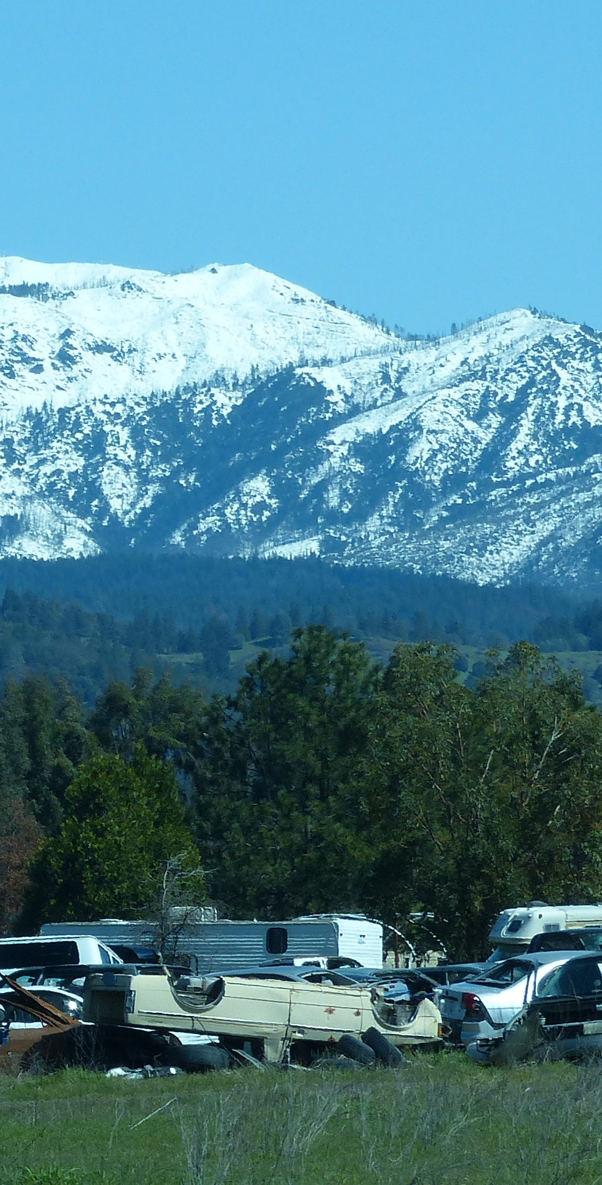
Mendocino County CDBG Projects
Current Projects
Past Projects
Round Valley Community Clean Up
(RVIT & MCRCD)
Micro-enterprise Business Technical Assistance (West Co.)
Business Assistance and Recovery Loan Fund
Town of Mendocino ADA Ramp
Pelicans Bluff ADA Coastal Trail
Mill Creek Park Fishing Platform ADA Improvement
Sun House Senior Housing
Acorn Valley Plaza Housing
Live Oak Apartments Transitional Housing

Slide 7
CDBG FUNDING
Program Income (PI)
Notice of Funding Availability (NOFA)
The County has approximately $600,000 in Program Income funds available for eligible CDBG projects.
Some CDBG activities, such as business assistance loans, generate program income, extending CDBG dollars further.
PI is defined as gross income generated from CDBG funds and may only be used for eligible CDBG projects or programs that comply with federal requirements.
The County is required to have a plan in place to use existing PI funds before applying for further CDBG funding.
The 2025 NOFA is expected to be published by HCD in June 2025, with applications opening in October 2025.
Currently, the precise level of CDBG funding available through the 2025 NOFA is unknown.
The 2024 NOFA allowed jurisdictions to apply for up to three projects with the combined funding for all activities not to exceed $3.6 million.
  Infrastructure or public facility project: up to $3.3 million
  Housing program: up to $1.5 million
  Economic development: up to $1.5 million
  Public services: up to $300,000
  Planning and technical assistance: up to $300,000

Slide 8
Schedule of Activities | Proposed Date
Applicant Workshop | March 7, 2025
Inquiry Deadline | March 14, 2025
RFP Submission Deadline | April 3, 2025
Approximate RFP Selection and Notification | April 2025
Approximate County Board of Supervisors Approval | May 2025
Approximate Contract Start Date | January 2026

Slide 9
Applications
Review RFP Document
Proposal Requirements
Compliance & Eligibility
Project description
Eligibility justification
  National objective
  Eligible activity
  Applicant eligibility
Budget & use of funds
Implementation plan
Experience & capacity
Community benefit
2 Letters of Support
CDBG Program form
Ensure project meets federal and state CDBG regulations.
Address environmental review, permitting, and other regulatory requirements.
Show capacity to manage grant funds and reporting obligations
Carefully review the RFP, listed guidelines & requirements.
Ensure project aligns with CDBG objectives.
Confirm organization is an eligible applicant.
Proposals due by 2pm April 3, 2025 to: Mendocino County Executive Office
Attn: Kelly Hansen, 501 Low Gap Road, Room 1010, Ukiah, CA 95482

Slide 10

Questions?
Submit questions by 3/14 to grantsdivision@mendocinocounty.gov
Questions about RFP 011-25 will be addressed in a forthcoming addendum.
10
CDBG

